Slide 1
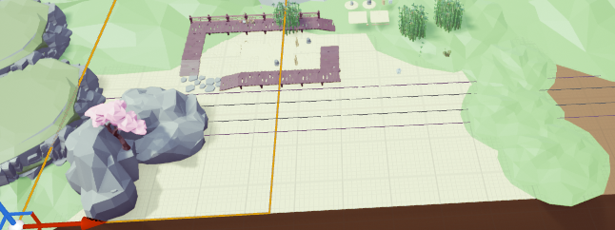
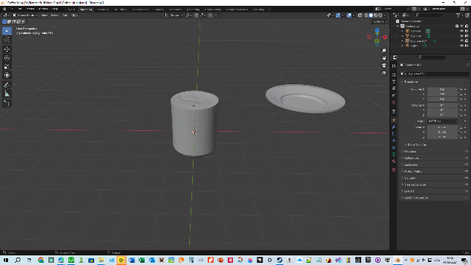
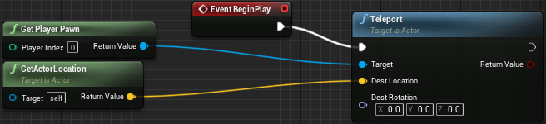
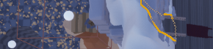
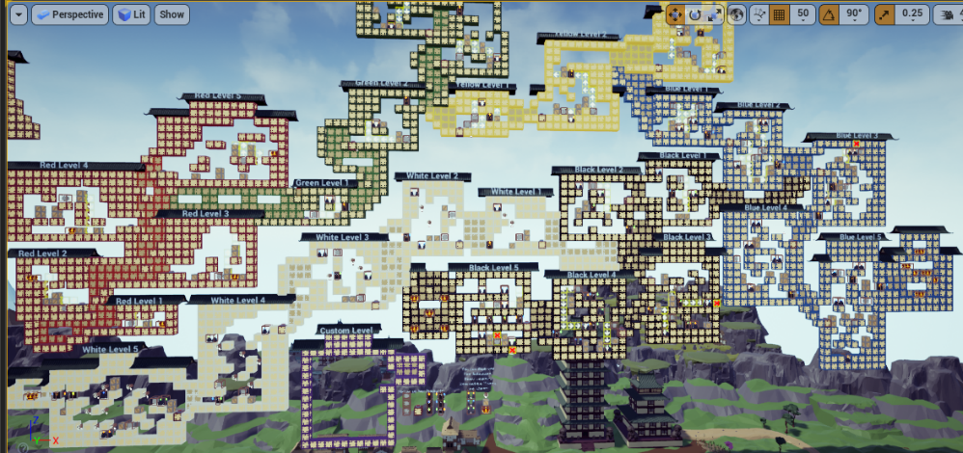
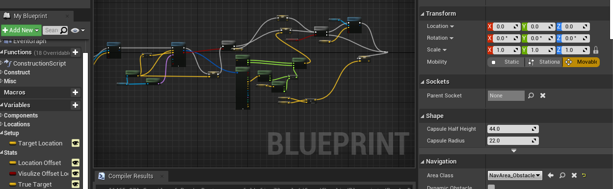
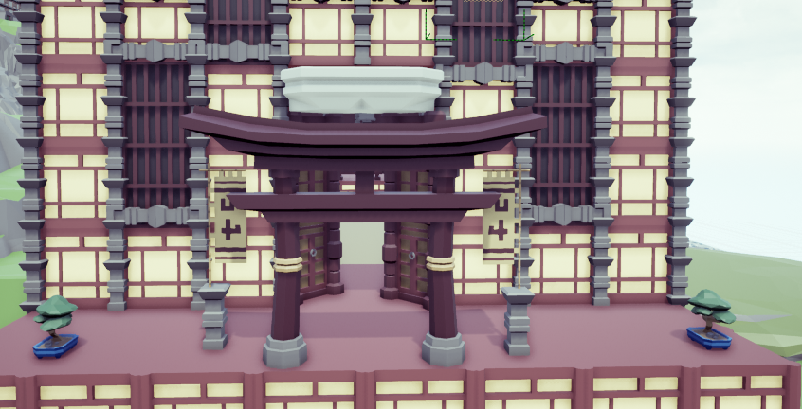
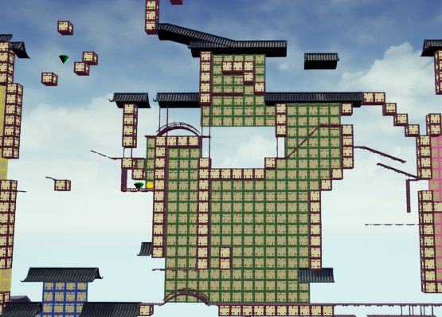
2024 Winter Term Presentation
Written by Charlie Hatch

Slide 2
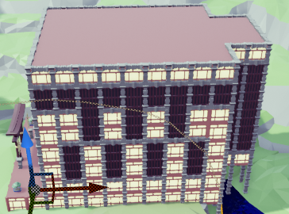
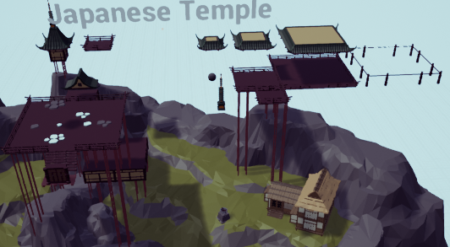
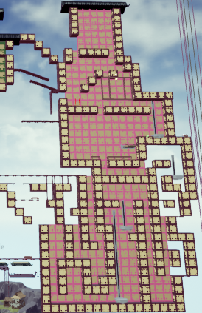
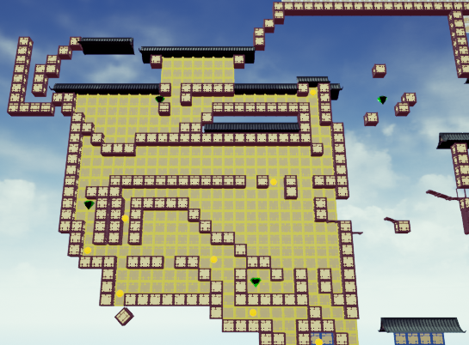
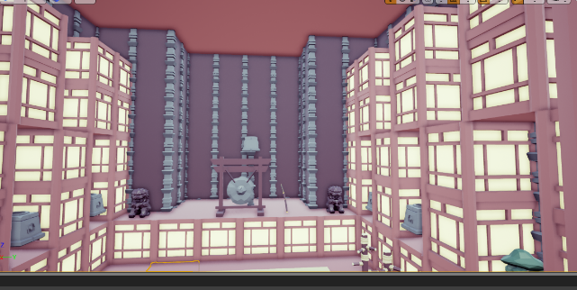
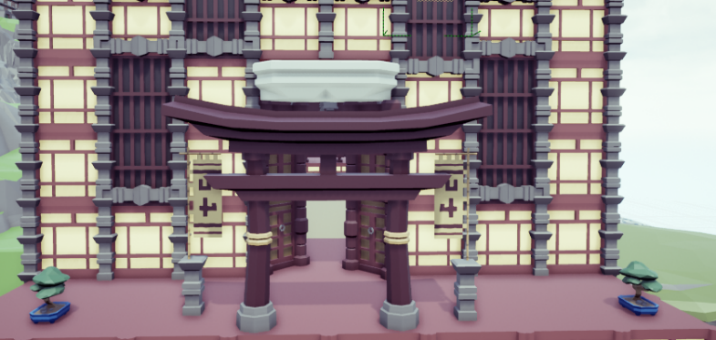
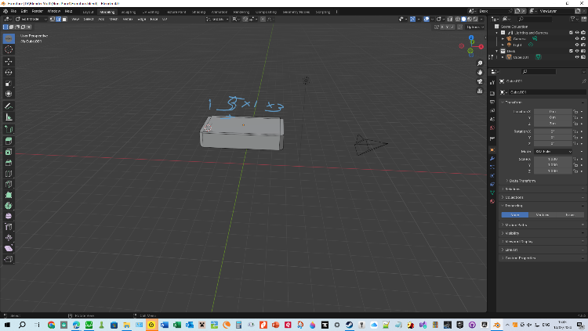
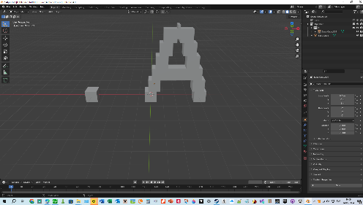
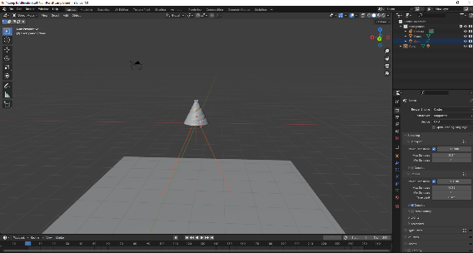
Things I learned in the “Intro to Tech” class
How to utilize Unreal Engine
3D and 2D level design via Unreal
How to use Blender
Notes:
The “3D” is 2.5D, not possible, fractal
While I learned basics, most of the stuff I figured out on own
No 2D images as those levels just didin’t turn out as good (something about me not likeing those games as much, so having less knowledge and understanding of them)
First blender image is the alphabet, mention funny story
My newer blender stuff is more intricate, but still much more WIP
Mention floating Japanese temple (3rd image)

Slide 3
Things learned core
Some tips for presenting
Information about how a lot of people don’t want help/ advice
Not sure why
Some tips for workplace ettiquite
Still don’t understand some, as the very definition’s (or how they are presented) are self-contradicting

Slide 4
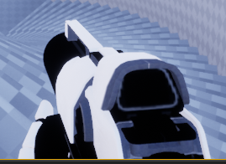
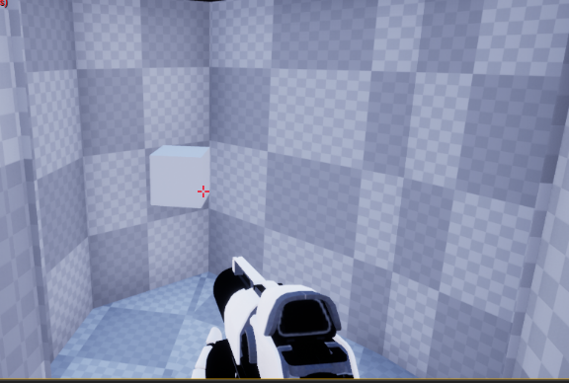
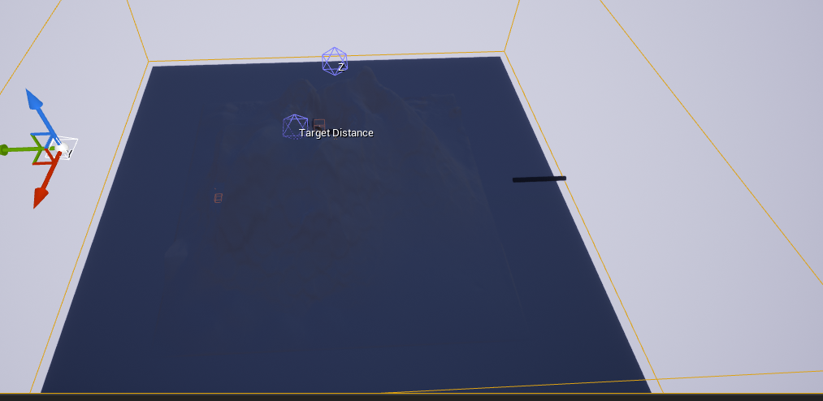
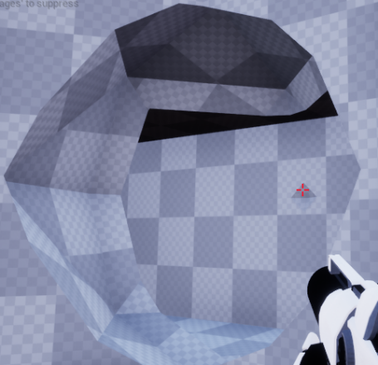
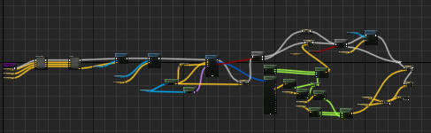
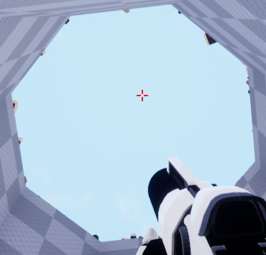
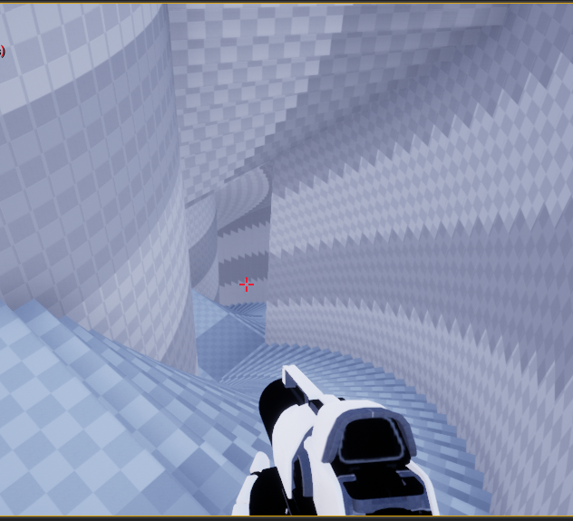
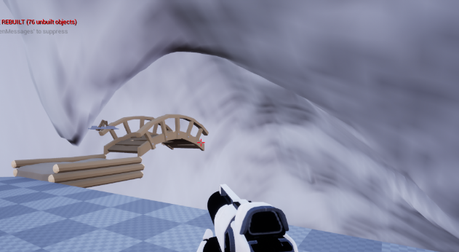

Design For All
Effectively my main work
In Design for All I:
Worked on a map
Made some blueprints so my map would work as I wanted
Notes:
Overview. Box is boundary port
Image showing “game” (not an fps but with gun. It’s “why do I have a gun”)
Entry area
View up cylandar
Entry to stairs and stairs
Teleporter to outside cylandar
Script for a system that teleports player to that object, so I can change player start spot for easy test
Code for the teleporters (image not found, probably deleted it)
Code for boundary port. Most of that is to adapt and ensure teleportation to terrain, not air

Slide 5
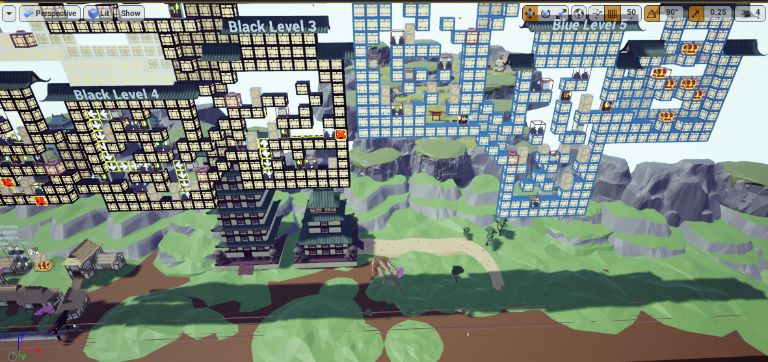
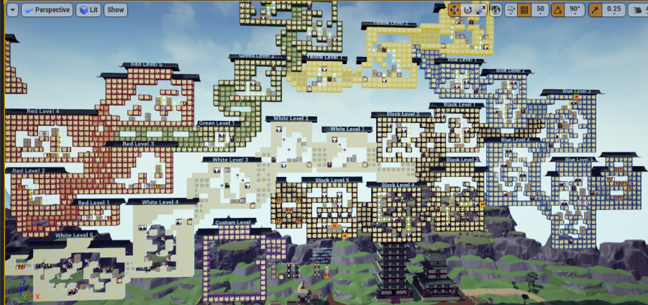
Favorite Memory
Wow, how is one supposed to pick a favorite memory?
Honestly, this was the hardest slide to figure out the answer
But, if I had to, I would probably go with meeting Chaz and Grace
And finding just how addictive scripting and coding is
enjoyable
Notes:
I don’t think like this. More like “good” and “bad” memories (to simplify it). So, picking one is not simple. At all.
Images are of scripting in intro to tech. not as fun as blueprints or code, but as I showed most of the blueprints earlier… oh, here’s one more
My personal favorite, it’s quite simple, but it was my first, and it’s so useful
Still not sure of answer
Chaz and grace- 2 of the few (I’ve ever met) whose desire to learn, help others, and grow rivals mine (and surpasses in some ways)

Slide 6
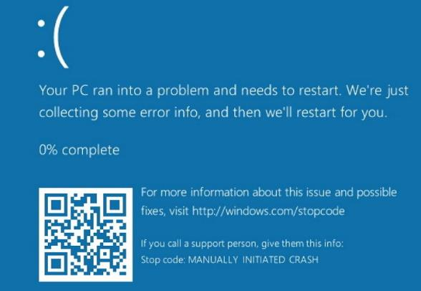
Notes:
Oh great…
After short duration, pretend to hit screen, and change slide

